Slide 1
Introduction to data-driven AI applications and multi-modal search
Ramya Oruganti,
Principal Product Manager
Microsoft

Slide 2
Agenda
Do you need an AI?
Introductions
Prerequisites for this tutorial
Demo application
AI is not just LLMs and GPT
Types of AI
Completions, embeddings and other LLM concepts
Multi-modal embeddings
Storing embeddings
Vector Search
Building AI applications in Python
(Hands on work)
Considerations for Production
Manual Experimentation
Automated Evaluation
Monitoring
Wrap Up

Slide 3

About your Speaker
Ramya Oruganti Principal Product Manager at Microsoft
Specializing in Azure Functions, containers and serverless technologies.
Active Contributor to open-source projects such as KEDA, Dapr and Functions in AKS (Azure Kubernetes Service).
Speaker at numerous developer, data & AI industry conferences and forums.
More than a decade experience in product management delivering impactful solutions that meet the evolving needs of customers and business.

Slide 4


Prerequisites for this workshop
Today, you will need:
Python 3.10+ (Required)
Github account (Required)
An editor
Azure subscription (Good to have)
Min 4CPU and 8 GB RAM (Required)
An intermediate knowledge of Python, we will be using the following concepts:
Functions, classes and variables
Async functions
Dictionaries and simple data structures
Testing libraries
Don’t have Python?
Here’s a great tutorial for installing Python:

Slide 5

Structure of the workshop
Where possible, we will include QR codes to any links – keep your phone handy!
Miss something? Don’t worry. The slides and the source code for this workshop will all be available online for the next 6 months.
https://aka.ms/pycon-id-workshop

Slide 6
Demo

Slide 7

Machine Learning vs. Artificial Intelligence
Machine Learning
Artificial Intelligence
ML is a specific type of AI that uses statistical learning algorithms to enable machines to learn from data.
Common types of Machine Learning include:
Statistical Modelling
Classification
Natural Language Processing
AI systems can perform complex tasks, such as “understanding” natural language, recognizing faces or emotions, and making recommendations.
Large Language Models are a form of Artificial Intelligence
AI can involve ML and other techniques to achieve a range of capabilities such as perception, reasoning and natural language processing.
AI and ML are not mutually exclusive.
ML is often used to train AI models to perform a specific task

Slide 8
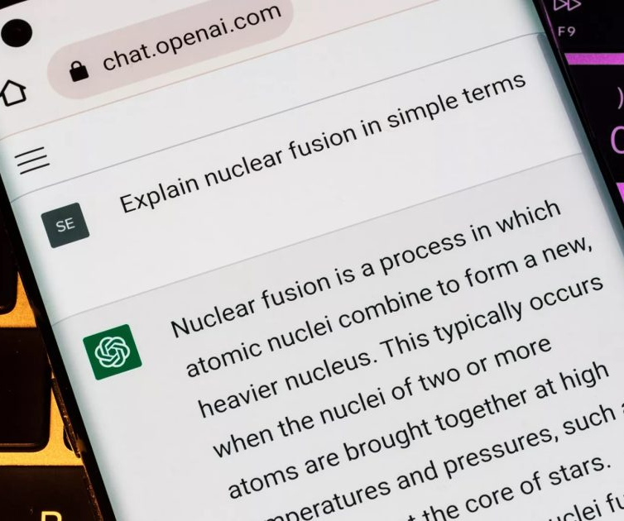
AI != ChatGPT
Logging + Authentication
Web UI
Tokenizer
System Prompt
Chat Completions Model
Model

Slide 9
OpenAI Models
MODEL | DESCRIPTION
GPT-4o | GPT for complex, multi-step tasks
GPT-4o mini | GPT for fast, lightweight tasks
DALL·E | A model that can generate and edit images given a natural language prompt
TTS | A set of models that can convert text into natural sounding spoken audio
Whisper | A model that can convert audio into text
Embeddings | A set of models that can convert text into a numerical form
Moderation | A fine-tuned model that can detect whether text may be sensitive or unsafe

Slide 10
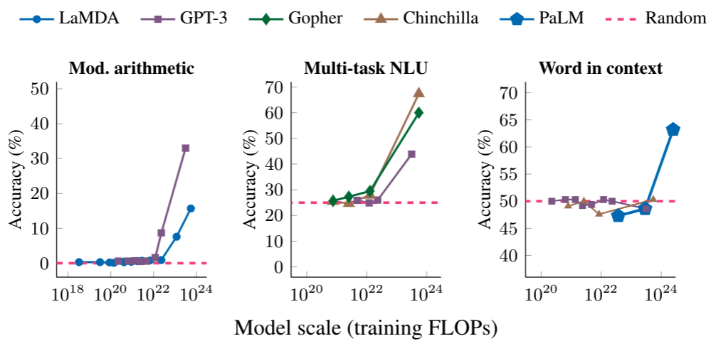
LLM: Large Language Model
An LLM is a model that is so large that it achieves general-purpose language understanding and generation.
Review: This movie sucks.
Sentiment: negative
Review: I love this movie:
Sentiment:
Input
LLM
Output
positive

Slide 11
Popular LLMs
Model | # of Parameters | Creator | Uses
GPT 3.5 | 175 B | OpenAI | ChatGPT, Copilots, APIs
GPT 4 | Undisclosed | OpenAI
Gemini | Undisclosed | Google | Bard
Claude 2,3 | 130 B | Anthropic | APIs
LlaMA | 70 B | Meta | OSS
Mistral-7B, Mixtral | 7 B | Mistral AI | OSS
Phi-3 | 3.8B | Microsoft Research | OSS

Slide 12
Using OpenAI LLMs: Python 🐍
response = openai.chat.completions.create(
messages = [
{
"role": "system",
"content": "You are a helpful assistant with very flowery language"
},
{
"role": "user",
"content": "what python frameworks does pamela use?"
}
])
for event in response:
print(event.choices[0].message.content)
🔗 https://github.com/pamelafox/python-openai-demos
Notes:
DEMO from python-openai-demos
DEMO of the quickstart example

Slide 13
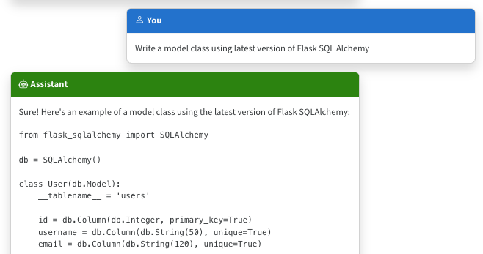
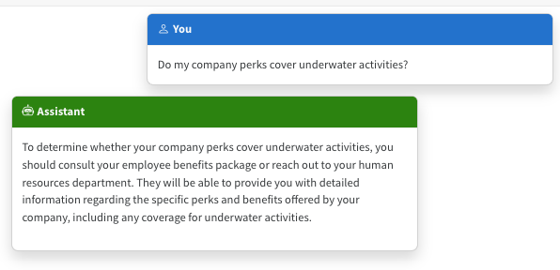
The limitations of LLMs
Outdated public knowledge
No internal knowledge

Slide 14
Incorporating domain knowledge
Prompt engineering
Fine tuning
Retrieval augmentation
In-context learning
Learn new skills
(permanently)
Learn new facts
(temporarily)

Slide 15
Retrieval-augmented generation (RAG)​
Notes:
Let's talk about RAG, Retrieval-Augmented Generation.

Slide 16
Retrieval Augmented Generation (RAG)
User question
Workflow
Retrieve related data
Retriever over Knowledge Base
Augment the prompt
Generate response
Large Language Model
Send Results

Slide 17
RAG: Retrieval Augmented Generation
For great hiking shoes, consider the TrekExtreme Hiking Shoes¹ or the Trailblaze Steel-Blue Hiking Shoes²
What's the best shoe for hiking?
[101]:
Name: TrekExtreme Hiking Shoes Price: 135.99
Brand: Raptor Elite
Type: Footwear
Description: The Trek Extreme hiking shoes by Raptor Elite are built to ensure any trail.
…
Large Language Model
User
Question
Search

Slide 18



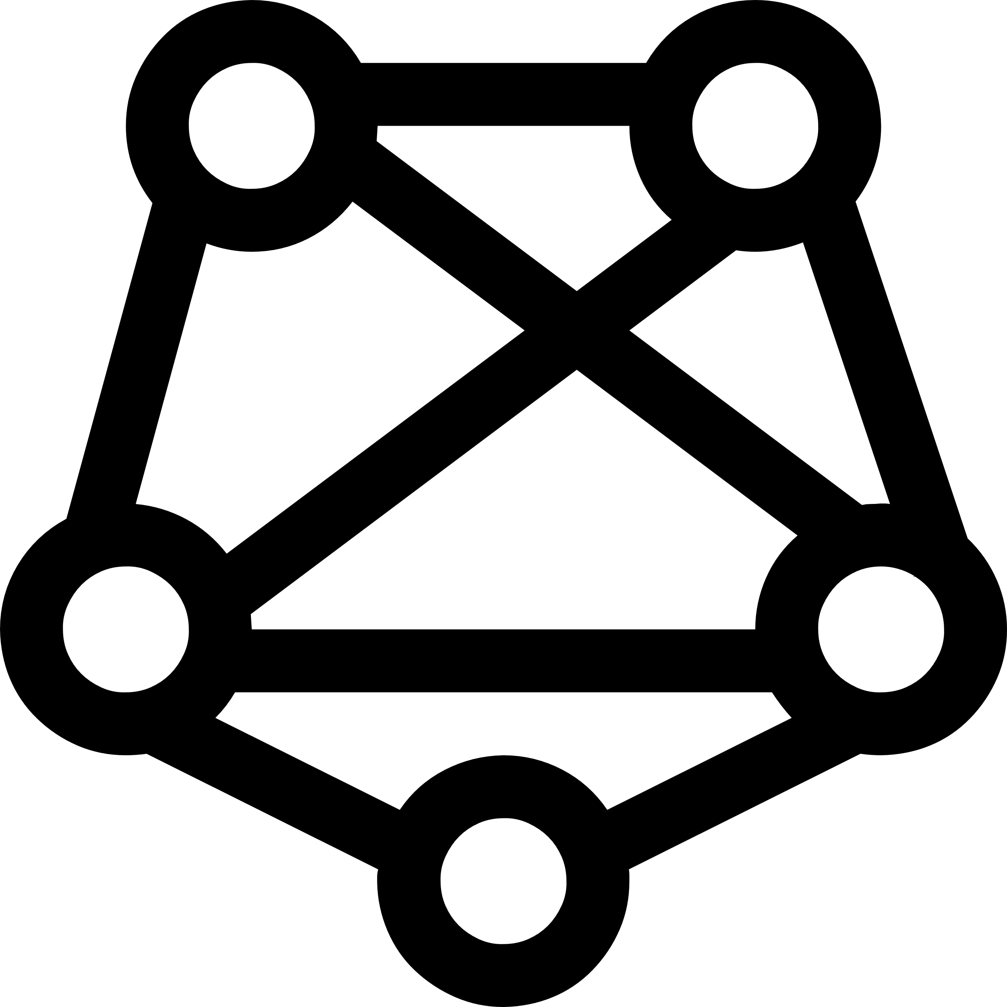
The importance of the search step
Garbage in, garbage out:
If the search results don’t contain a good answer, the LLM will be unable to answer or will answer wrongly.
Noisy input:
If the LLM receives too much information, it may not find the correct answer amidst the noise.
Source: Lost in the Middle: How Language Models Use Long Contexts, Liu et al. arXiv:2307.03172
Accuracy
Number of documents in input context
Notes:
<<show the demo sample with RAG in action>

Slide 19


What is the RAG searching?
Database rows
(Structured data)
Documents
(Unstructured data)
PDFs, docx, pptx, md, html, images
You need a way to vectorize & search target columns.
PostgreSQL + pgvector
Cosmos MongoDB
Eventhouse in Microsoft Fabric
Azure SQL + vector search (upcoming)
You need an ingestion process
for extracting, splitting, vectorizing,
and storing document chunks.
Azure AI Search +
Integrated Vectorization
Document Intelligence or

Slide 20
Components of a high-quality RAG
1
2
3
Sophisticated LLM
Adheres to instructions
Supports function calling
Well prepared data
Reasonably sized text
Meaningful vectors
Powerful search functionality
Vector search
Hybrid search
Semantic re-ranking
Filtering
Powerful search functionality
Vector search
Hybrid search
Semantic re-ranking
Filtering
Well prepared data
Reasonably sized text
Meaningful vectors
Sophisticated LLM
Adheres to instructions
Supports function calling

Slide 21
Vectors 101

Slide 22
Vector embeddings
An embedding encodes an input as a list of floating-point numbers.
”dog” → [0.017198, -0.007493, -0.057982,…]
Different models output different embeddings, with varying lengths.
Model | Encodes | MTEB Avg. | Vector length
word2vec | words |  | 300
Sbert (Sentence-Transformers) | text (up to ~400 words) |  | 768
OpenAI text-embedding-ada-002 | text (up to 8191 tokens) | 61.0% | 1536
OpenAI text-embedding-3-small | text (up to 8191 tokens) | 62.3% | 512, 1536
OpenAI text-embedding-3-large | text (up to 8191 tokens) | 64.6% | 256, 1024, 3072
Azure Computer Vision | image or text |  | 1024
💻 Demo: Compute a vector with OpenAI model

Slide 23
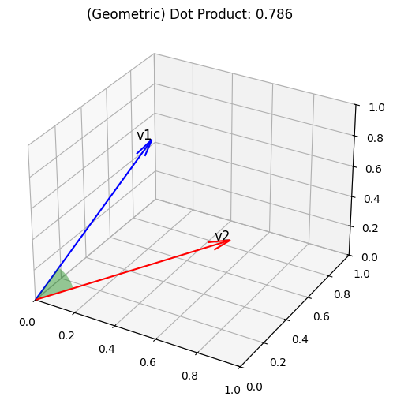
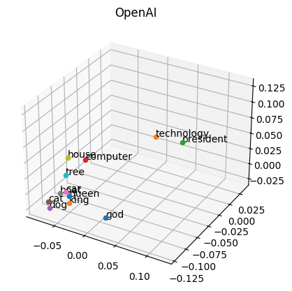
Vector similarity
We compute embeddings so that we can calculate similarity between inputs.
The most common distance measurement is cosine similarity.
def cosine_sim(a, b):
return dot(a, b) /
(mag(a) * mag(b))
For ada-002, cosine similarity values range from 0.7-1
💻 Demo: Compare vectors with cosine similarity

Slide 24
Vector search
1
Compute the embedding vector for the query
2
Find K closest vectors for the query vector
Search exhaustively or using approximations
Compute embedding vector
Search
existing vectors
Query
Query vector
K closest vectors
OpenAI
create embedding
[-0.003335318, -0.0176891904,…]
Search
existing vectors
[[“snake”, [-0.122, ..],
[“frog”, [-0.045, ..]]]
“tortoise”
💻 Demo: Search vectors with query vector

Slide 25


Vector databases in Azure
Vectors in Azure databases
Azure AI Search
Keep your data where it is: native vector search capabilities
Best relevance: highest quality of results out of the box
Built into:
Azure Cosmos DB MongoDB vCore
Azure PostgreSQL services
Eventhouse in Microsoft Fabric
Azure SQL server (upcoming)
Automatically index data from Azure data sources: SQL DB, Cosmos DB, Blob Storage, ADLSv2, and more

Slide 26
Storing Embeddings as Vectors
If a vector is just a series of numbers, do I need a Vector Database?
You can store a vector in any database, you can’t efficiently search over it.
Vector databases give you
A special column type for efficient storage of vectors
Indexes for searching vector columns with similarity algorithms
Some vector databases also give you
Integrated vectorization (it converts another column like text into a vector for you)
Fine-tuned search and filtering

Slide 27

Optimal relevance: Hybrid search + Semantic ranker
Question: "What underwater activities can I do in the Bahamas?"
Keyword results
1 | Scuba Diving in Bahamas
Fusion (RRF)
Reranking model
1 | Scuba Diving in the Carribean
2 | Scuba Diving in Bahamas
3 | Water skiing in Seychelles
1 | Scuba Diving in Bahamas
2 | Scuba Diving in the Carribean
Vector results
1 | Scuba Diving in the Carribean
2 | Water skiing in Seychelles
💻 Demo: Compare text, vector, hybrid, reranker (aka.ms/aitour/search-relevance)

Slide 28
Example database schema
Defined with SQLAlchemy ORM:
class Item(Base):
__tablename__ = "items"
id: Mapped[int] = mapped_column(primary_key=True, autoincrement=True)
type: Mapped[str] = mapped_column()
brand: Mapped[str] = mapped_column()
name: Mapped[str] = mapped_column()
description: Mapped[str] = mapped_column()
price: Mapped[float] = mapped_column()
embedding: Mapped[Vector] = mapped_column(Vector(1536))
Notes:
TODO: Generating the embedding column

Slide 29
Demo – Vectorizing data in Azure Functions

Slide 30
What we are building today
Web App
Database
Vector Search
Serverless Function
AI Models

Slide 31
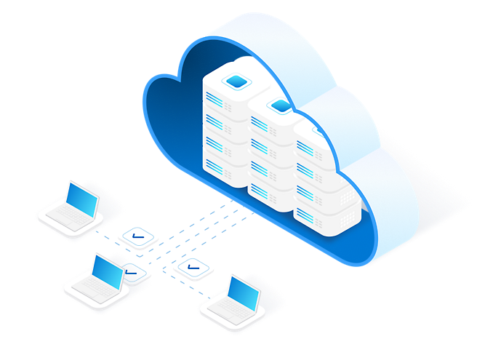

Azure Functions for intelligent apps
Preview of Azure OpenAI Triggers and Bindings
RAG (work with your own organizations data)
Embeddings and search
Pluggable with Azure AI Search, CosmosDb for Mongo DB, Azure Data Explorer
Configurable models for embedding and search
Integrate with existing http & event triggers for real-time data ingestion
Chat and assistant skills
Chat with OpenAI models with automatic persistent history
Assistant skills trigger to extend capabilities of OpenAI model
Text completion for content summarization and creation
Input binding that takes prompt or content and returns LLM response
Durable Functions for chaining and orchestrations

Slide 32



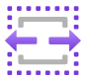
Azure Functions on Azure Container Apps
Generally available
Build multiple app types, containerized microservices that share common Container App environment
Develop your way with integrated programming model with triggers and bindings
Seamless end-to-end development experience
Scale dynamically and pay-per-use

Slide 33
Hands on app building
Notes:
In this section, the trainer will show the application and walk through the different stages to get it working.
Setting up a storage container
Configuring a serverless function in Python to run whenever pictures are added to the storage container
Converting an image into an embedding
Setting up a vector database
Storing embeddings in a vector database
Creating search queries and similarity functions
Improving our search page
Adding a user-provided image upload to the site
Doing text-image and image-text relevance queries
Filtering data in queries

Slide 34
Considerations for Production

Slide 35
Are the answers high quality?
Are they clear and understandable?
Are they correct? (relative to the knowledge base)
Are they formatted in the desired manner?
Yes, according to the information provided in the PerksPlus.pdf document, underwater activities such as scuba diving are covered under the program.
Do the perks cover underwater activities?
Yes, the perks provided by the PerksPlus Health and Wellness Reimbursement Program cover a wide range of fitness activities, including underwater activities such as scuba diving. The program aims to support employees' physical health and overall well-being, so it includes various lessons and experiences that promote health and wellness. Scuba diving lessons are specifically mentioned as one of the activities covered under PerksPlus. Therefore, if an employee wishes to pursue scuba diving as a fitness-related activity, they can expense it through the PerksPlus program.
Yes, underwater activities are included as part of the PerksPlus program. Some of the underwater activities covered under PerksPlus include scuba diving lessons [PerksPlus.pdf#page=3].

Slide 36
What affects the quality?
Large Language Model
Question
Search
Search engine (ie. Azure AI Search)
Search query cleaning
Search options (hybrid, vector, reranker)
Additional search options
Data chunk size and overlap
Number of results returned
System prompt
Language
Message history
Model (ie. GPT 3.5)
Temperature (0-1)
Max tokens

Slide 37
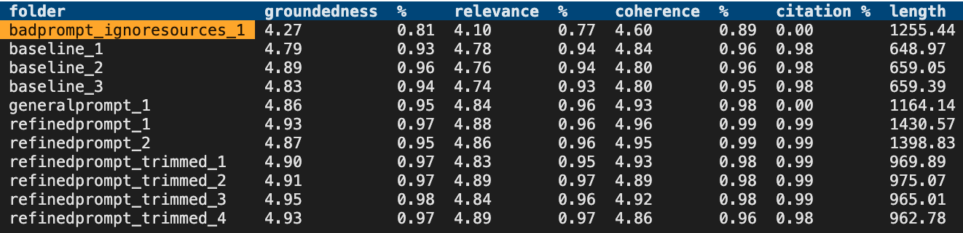
Evaluation approaches
Evaluate the retrieval system
Recall, precision, NDCG/MAP
aka.ms/ragrelevance
Evaluate language models
Shifting space, many metrics, consider your task.
chat.lmsys.org/?leaderboard
Evaluate the full RAG stack for quality and safety
AI Studio or promptflow-evals for GPT-based evaluations and metrics→ At Build: BRK107:
aka.ms/ragchat/eval
Basic SKU now supports up to 3 partitions, up from a single partition
Limits are GB/partition

Slide 38
LLM Ops for LLM Apps
1. Ideating/exploring
2. Building/augmenting
3. Operationalizing
Identify business use case
Run app against sample questions
Run flow against larger dataset
Deploy app to users
Try different parameters
Evaluate answers
Add monitoring and alerts
Connect to your data
Change defaults
Evaluate user feedback
Customize prompt for domain
Improve the prompt and orchestration
Satisfied?
Yes
Satisfied?
Yes
No
No

Slide 39
Manual
experimentation
Notes:
And gaining intuition

Slide 40
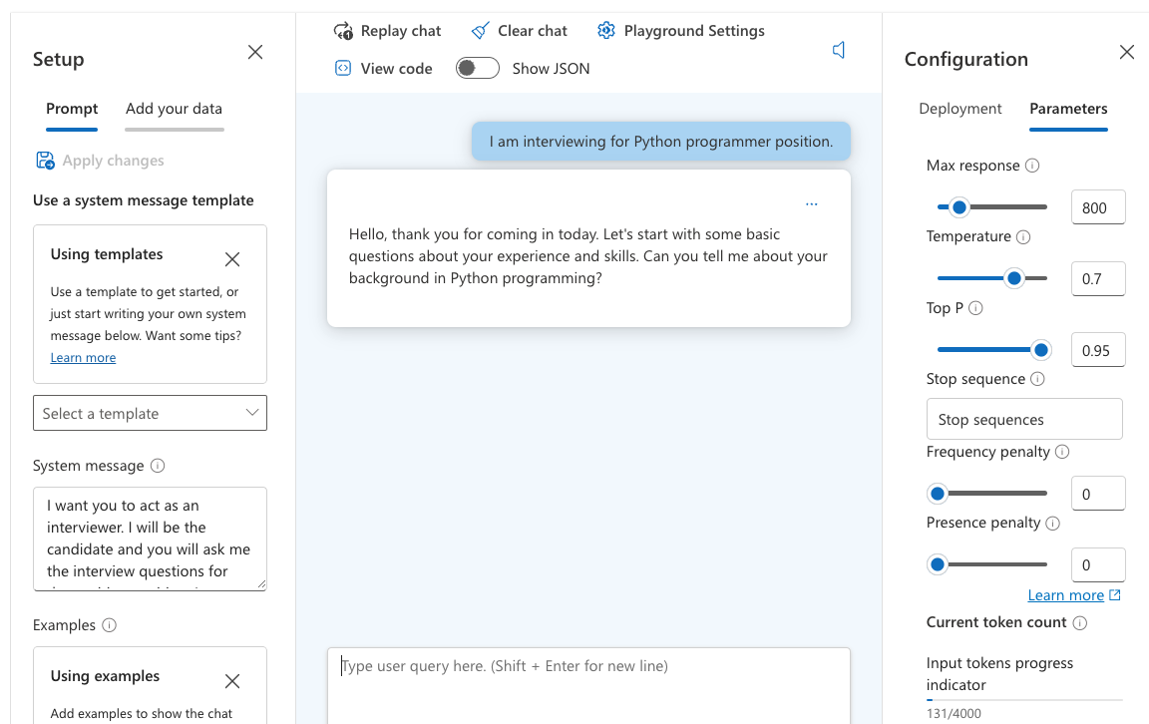
Experimenting with quality factors
Find an easy way to experiment with settings in your LLM app.
Azure OpenAI Studio Playground →

Slide 41
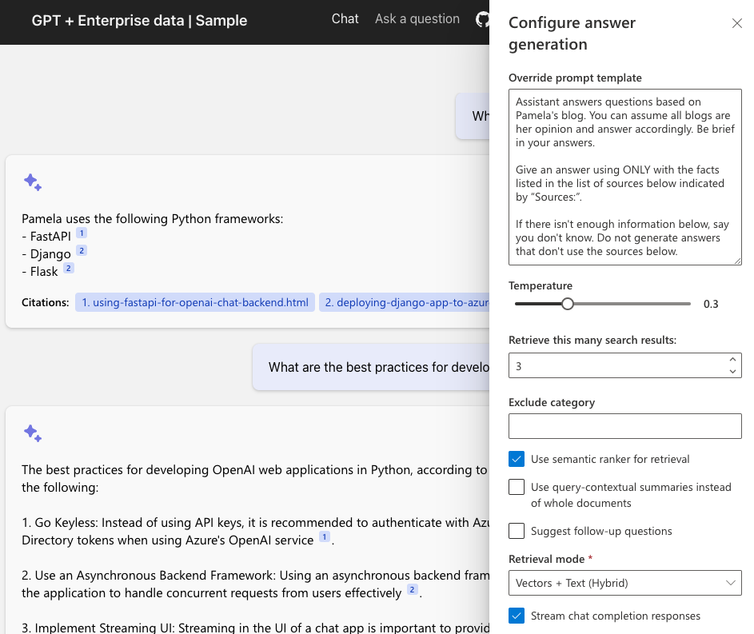
Experimenting with quality factors
aka.ms/ragchat
“Developer Settings” →

Slide 42
Automated
Evaluation
Notes:
And gaining intuition

Slide 43
AI RAG Chat Evaluator
A set of tools for automating the evaluation of RAG answer quality.
Generate ground truth data
Evaluate with different parameters
Compare the metrics and answers across evaluations
https://github.com/Azure-Samples/ai-rag-chat-evaluator
aka.ms/rag/eval
Based on the azure-ai-generative SDK:
https://pypi.org/project/azure-ai-generative/

Slide 44



Ground truth data
The ground truth data is the ideal answer for a question.
Manual curation is recommended!
Generate Q/A pairs from a search index:
python3 -m scripts generate --output=example_input/qa.jsonl
--numquestions=200 --persource=5
documents
prompt + docs
Q/A pairs
Azure
AI Search
azure-ai-generative
SDK
Azure OpenAI

Slide 45

Evaluation
Compute GPT metrics and custom metrics for every question in ground truth.
Evaluate based off the configuration:
python3 -m scripts evaluate -–config=example_config.json
gpt_coherence
response
+ ground truth
gpt_groundedness
question
prompt
metrics
gpt_relevance
length
Local endpoint
azure-ai-generative
SDK
Azure OpenAI
has_citation

Slide 46
Review the metrics across runs
After you’ve run some evaluations, review the results:
python3 -m review_tools summary example_results

Slide 47
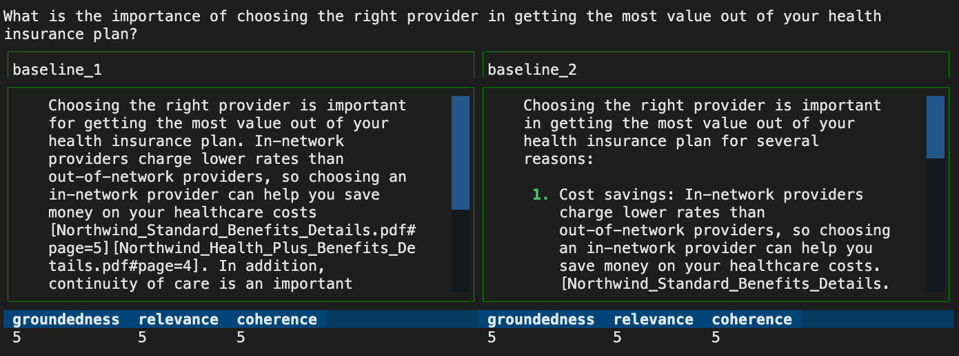
Compare answers across runs
python3 -m review_tools diff example_results/baseline_1
example_results/baseline_2

Slide 48
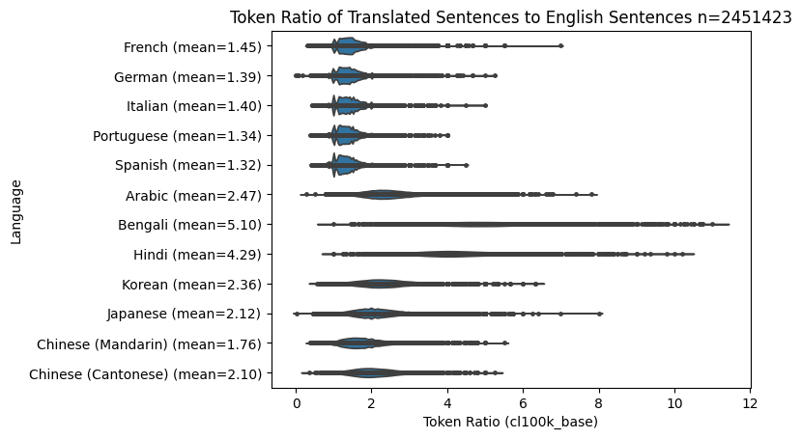
Localization for LLMs

Slide 49
Text Splitting by Tokens
The most effective model for splitting any language into a desired number of tokens is the Recursive Character Splitter combined with the Token-Based splitter:
from langchain_text_splitters import RecursiveCharacterTextSplitter
text_splitter = RecursiveCharacterTextSplitter.from_tiktoken_encoder(
model_name="gpt-4", # required for byte-pair encoding model
chunk_size=500, # desired chunk side
chunk_overlap=0, # 10-20 is efficient for overlap
)

Slide 50
Monitoring AI Applications

Slide 51



OpenTelemetry Architecture
Instrumentation
Collector
Exporter
Traces
Long term storage
Search
Automated Instrumentation
Client Instrumentation Libraries
Custom Instrumentation using the SDK
A service proxy of all instrumented data.
Telemetry Data
Metrics
Logs
Your Application
User Interface

Slide 52
Observability Concepts
Traces
Metrics
Logs
Trace units of work are called spans
Spans can have attributes
Spans are created by instrumentation libraries or manually via the SDK
Spans are nested
Spans have kinds
Client, or Server,
Internal,
Producer or Consumer
Metrics are measurements captured at runtime
Metrics are created by meters
Meters are defined in instrumentation libraries or manually via the SDK
Meters can be aggregate or live
Logs are a timestamped text record
Logs can be structured (with data) or unstructured (just text)
Log exporters can plug into existing logging infrastructure

Slide 53

AI SDK Support for OpenTelemetry
* requires additional code
Traces
Metrics
Logs
Semantic Kernel .NET
OpenAI SDK Client (Python, JavaScript)
*
Azure SDK (Python, JavaScript, .NET)
PromptFlow (Python)

Slide 54
3rd Party Support for OpenTelemetry
* requires additional code
Traces
Metrics
Logs
LangChain
Elastic [1]
Redis [2]
LlamaIndex [3]

Slide 55
Securing your RAG
Notes:
Now let's talk about security. If you're building an app for internal use in an enterprise, you want to ensure that it can only be accessed internally.

Slide 56
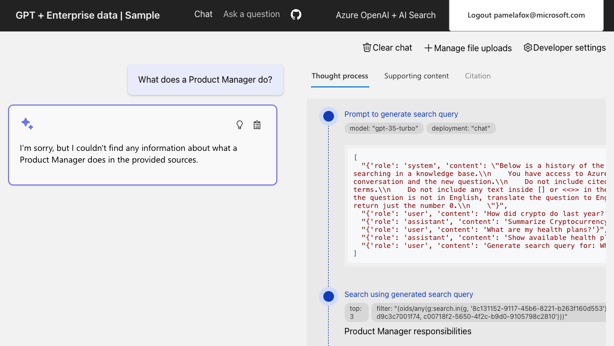
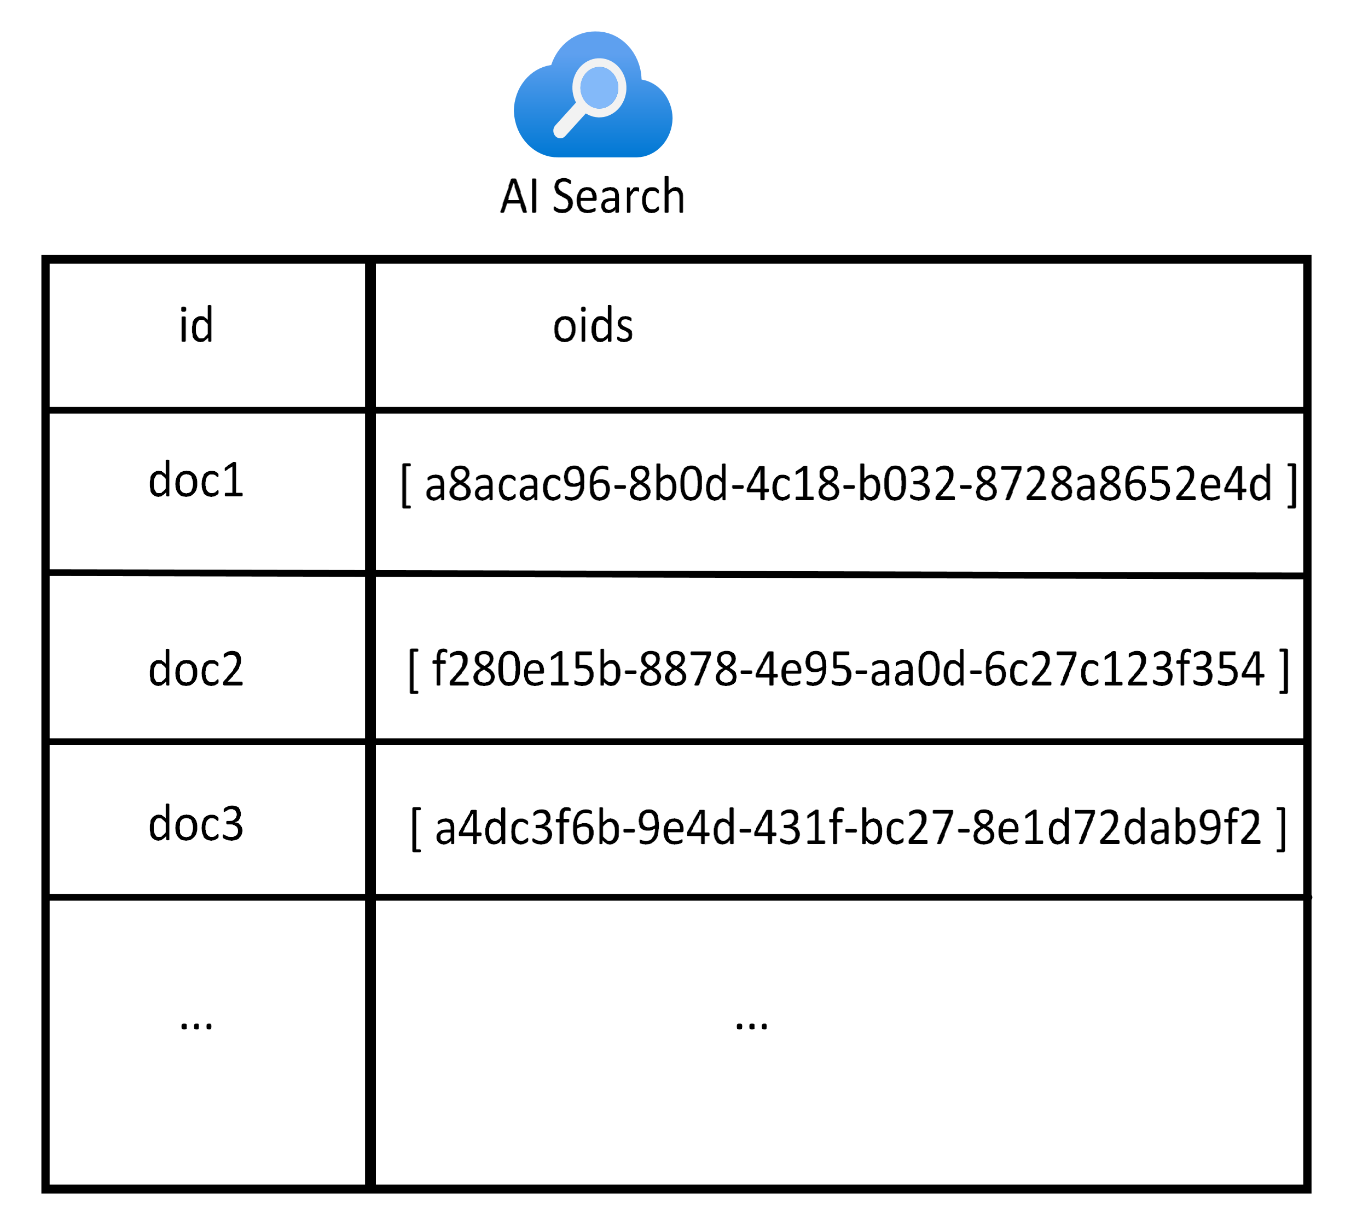
User login and data access control
aka.ms/ragchat/acl
Search index includes fields for oid and groups from Microsoft Entra:
Notes:
One way to secure your RAG app is to add user login to the app, to enforce that only users from your organization can login. When you enable this option, you can also allow the users to upload documents for their own personal search needs, and enforce data access controls in the search filter.

Slide 57
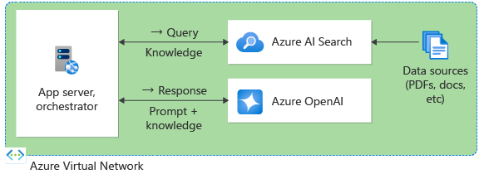
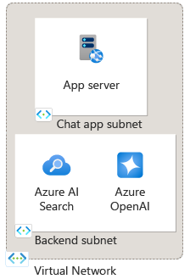
Private network deployment
Put all resources in a virtual network:
Use subnets for further isolation:
Notes:
Another way to ensure internal access is to deploy it to a virtual network, with all the services available via private endpoints, and access only from inside the virtual network.

Slide 58
Where next?
1
Learn more about Vector Databases
aka.ms/AzureAISearch
2
Dig more into quality evaluation details
aka.ms/ragrelevance
3
Deploy a RAG chat application for your organization’s data aka.ms/azai/python
4
Explore Azure AI Studio for a complete RAG development experience aka.ms/AzureAIStudio

